Slide 1
Java Servlets 02
Spring Valley Tech Corp ∙ Java SMP+ Teacher Training ∙ Jorge Cosgayon

Slide 2
GET data
GET data is sent via the URL as key value pairs
<server>?key=value&key=value…
Servlets handles form data parsing automatically using the following methods depending on the situation −
getParameter() − You call request.getParameter() method to get the value of a form parameter.
getParameterValues() − Call this method if the parameter appears more than once and returns multiple values, for example checkbox.
getParameterNames() − Call this method if you want a complete list of all parameters in the current request.

Slide 3
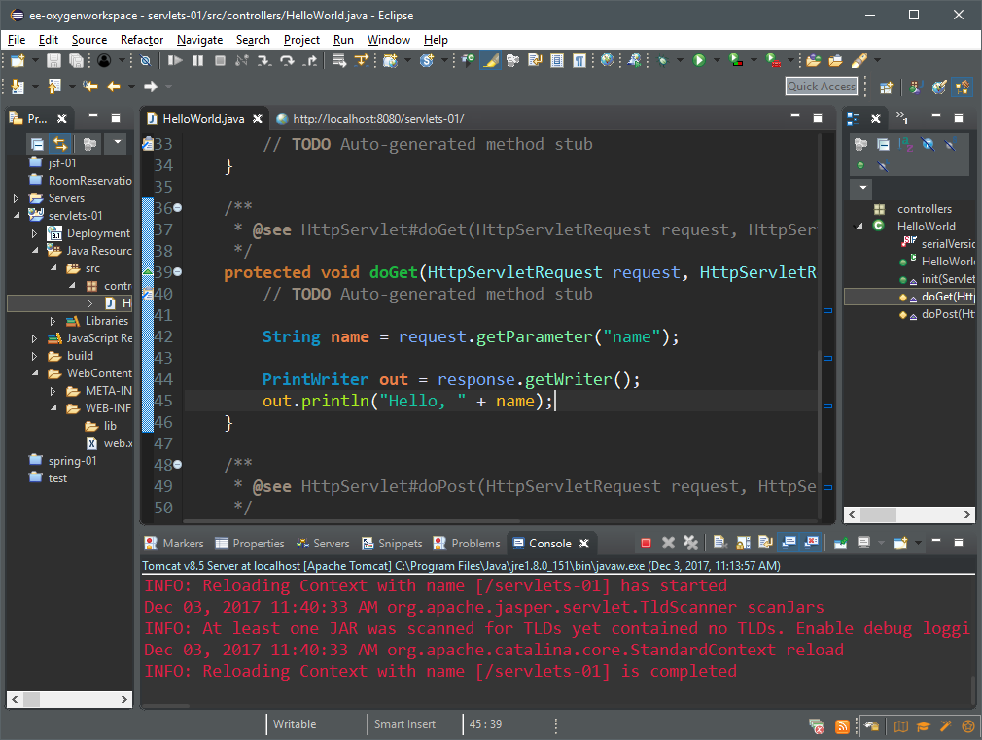
We use a PrintWriter object to enable us to write our response directly to the browser

Slide 4
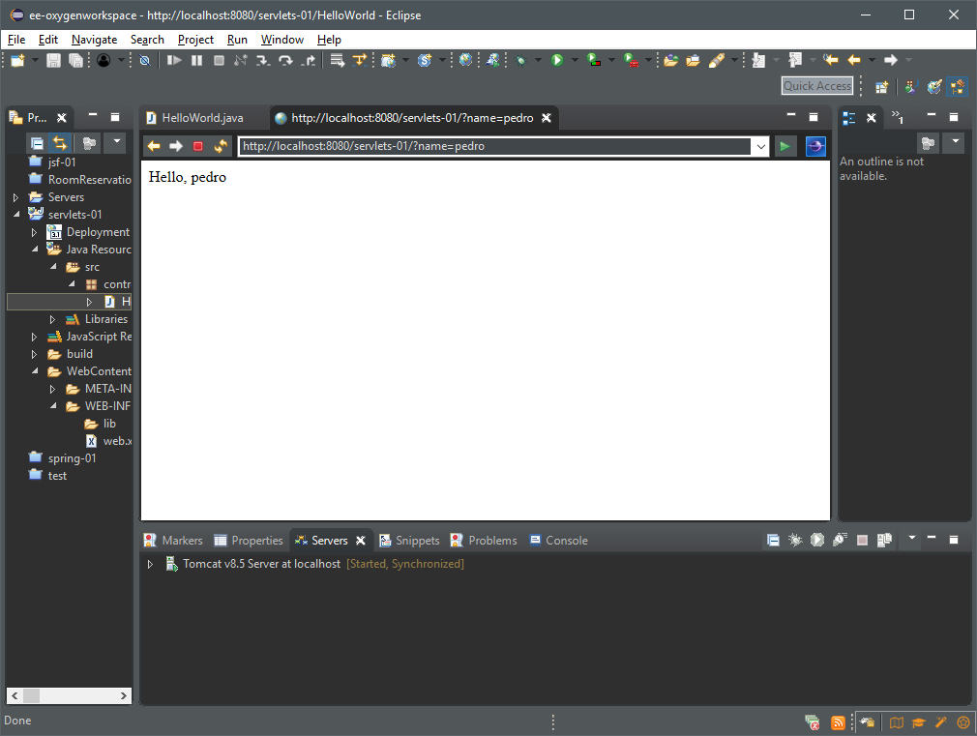
The URL parameter “name” is assigned the value “pedro” and is displayed on the page

Slide 5
Let’s make a simple calculator
Project parameters:
Allow two numeric values as input
Perform a simple arithmetic operation on the values (+, -, /, *)
Display the result
Project reference:
servlets-02
Activity type:
Demonstration

Slide 6
Objectives
Create a servlet that will handle the business logic of performing a simple arithmetic operation on two numbers
Create a JSP file to handle input
Create a JSP to display output
Invoke the servlet to dispatch the proper files to the server

Slide 7
Outcomes
Learner knows how to create and call JSP files from a servlet
Learner understands how to capture data sent to the servlet from a JSP file
Learner understands how to send data from the servlet back to a JSP file

Slide 8
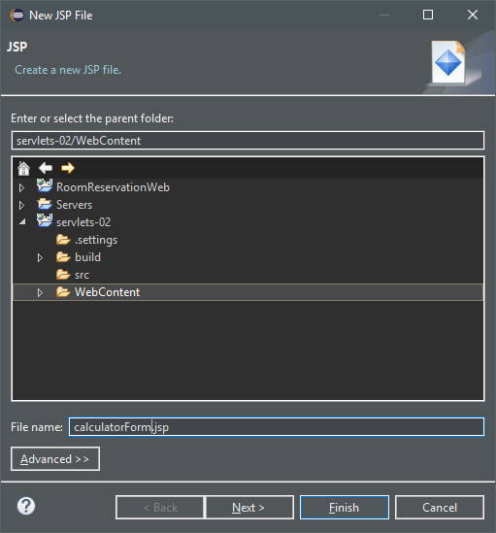
Right-click the WebContent folder, and select new JSP file
Let’s call it calculatorForm.jsp
This will contain the HTML form
Let’s also create another file, calculatorResult.jsp
This will contain the result of the operation
For now, don’t bother with a JSP template

Slide 9
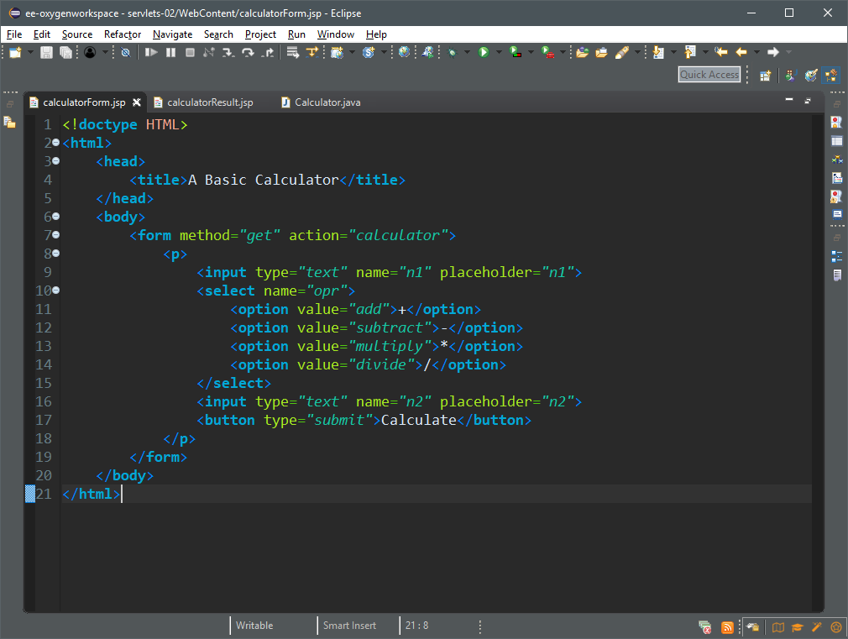
Path to the process that will handle this request; we’ll be creating a servlet for this

Slide 10
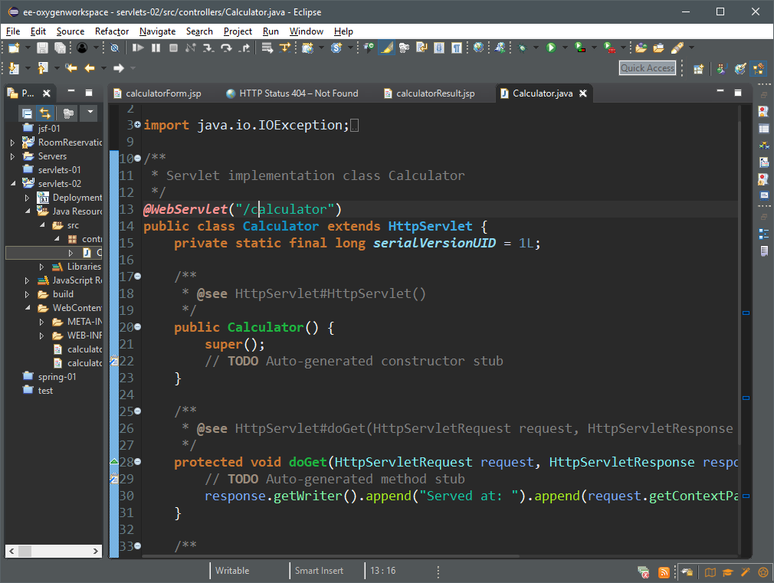
The @WebServlet annotation maps the url to this servlet
http://localhost:8080/servlets-02/calculator
We will be writing the logic to handle this GET request in the doGet() method

Slide 11
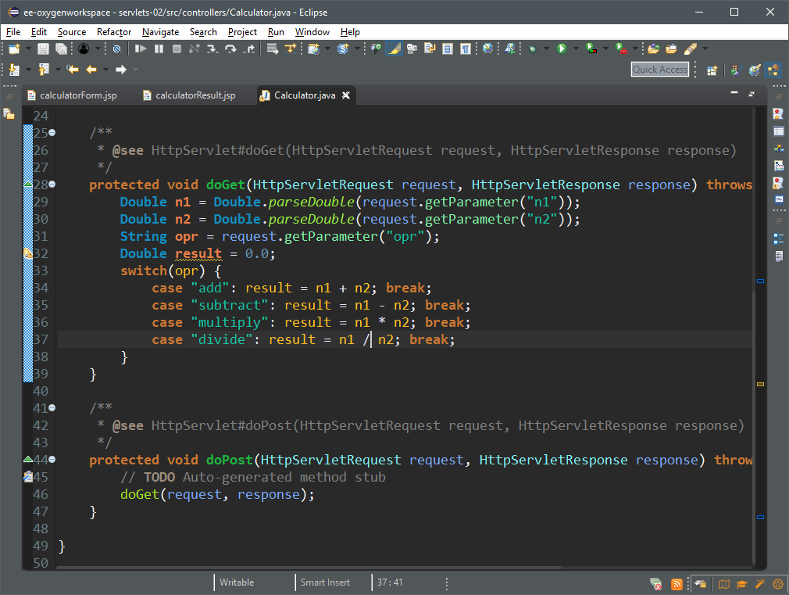
You call the request.getParameter() method to get the value of a form parameter.

Slide 12
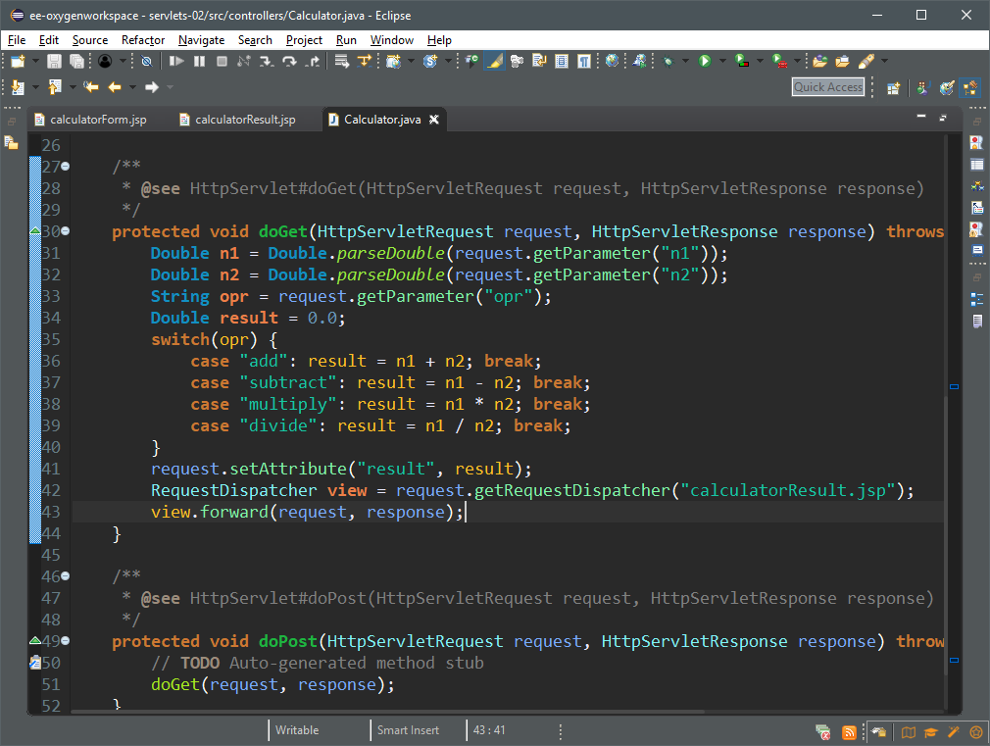
We use the request.setAttribute() method to store values that we want to “dispatch” to another handler
We create a RequestDispatcher object which will render our “view”, and associate it with a JSP file
We forward our request and response data to the view

Slide 13
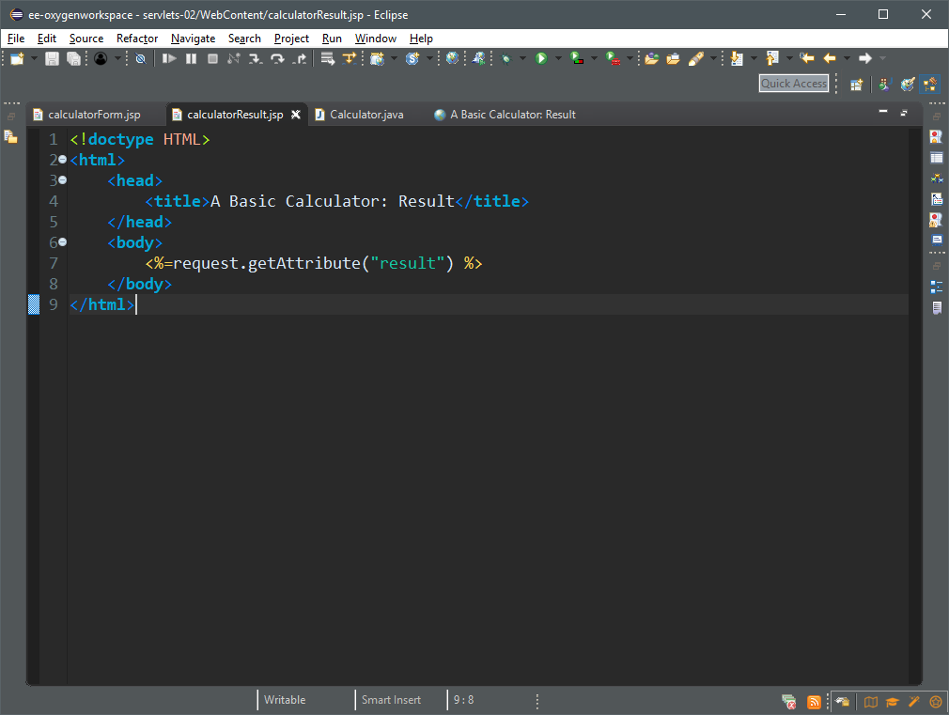
We get and display the attribute “result” in the request object

Slide 14
Activity Suggestion
Objectives
Use doPost() instead of doGet() to handle form submission
Outcomes
Learner demonstrates understanding of GET and POST data
Learner demonstrates ability to adapt to new requirements
KPI
Learner refactored servlet to use doPost() instead of doGet()
Refactor the code to use POST data instead

